Slide 1
Different approaches for deployment of BSNL Franchisee OLT using BharatNet

Slide 2
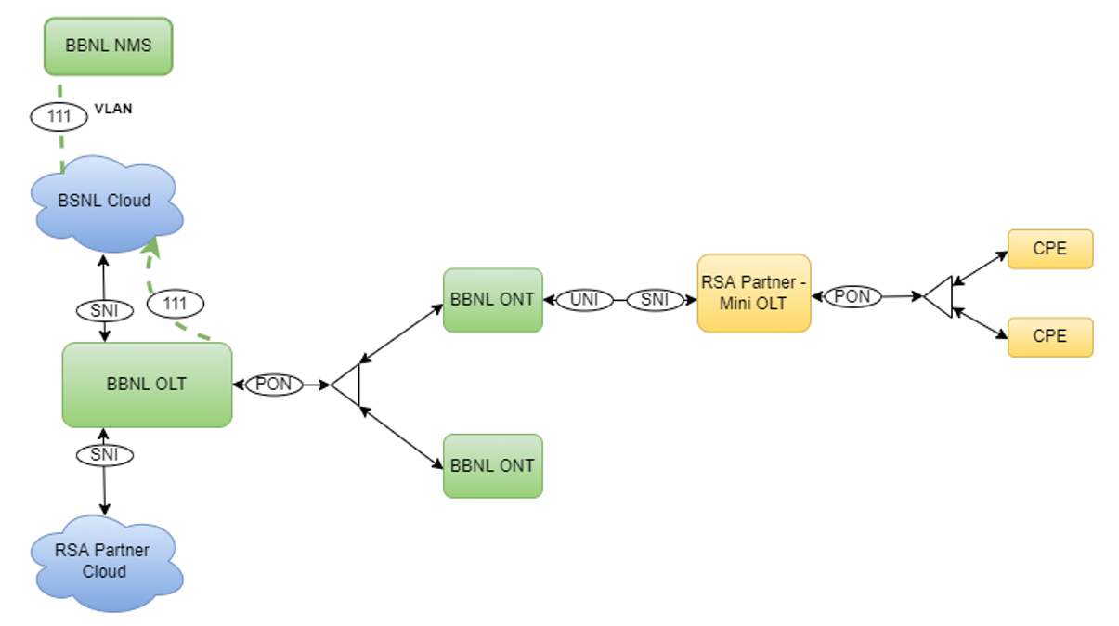
BBNL Existing Setup of connectivity with RSA Partners

Slide 3
BSNL Existing Setup for TIP OLT connectivity

Slide 4
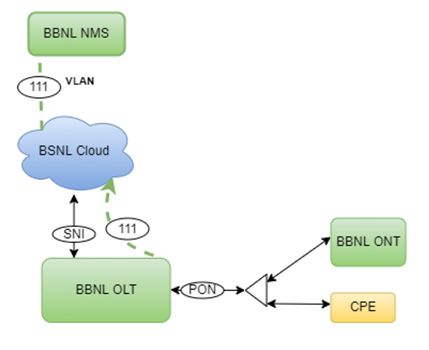
Possibility 1: Block/GP level connections from BBNL OLT Model 3(Rural)
Only in an exceptional scenario where few connections are required at GP location or near OLT location (directly from PON port using BSNL/TIP ONT)
Configurations required at BBNL OLT & BSNL ONT will be done from BBNL NMS by the BBNL NOC team
BSNL ONT should be compatible with the BBNL OLT. Link budget considerations

Slide 5
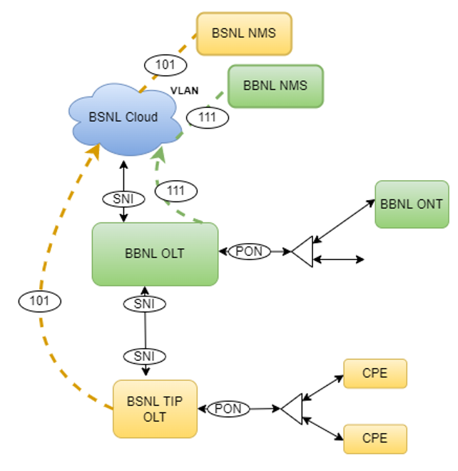
Possibility 2: Block/GP level connections through partner OLTs cascaded with BBNL OLT for SNI/Backhaul
(Model 4-1)
In this scenario, only SNI ports of BBNL OLT will be used.
TIP OLT backhaul can be extended from BBNL OLT using spare fibre available between BBNL OLT and TIP OLT location
BBNL OLT will pass the VLANs (Service & Management traffic) transparently from BSNL backhaul to the BSNL TIP OLT through SNI Ports
There is no limitation on the number of VLANs that can be passed. VLANs used in BBNL & BSNL TIP OLT should be mutually exclusive.
SNI port availability at BBNL OLT to be checked. For each BSNL TIP OLT, separate SNI port is required at the BBNL OLT

Slide 6
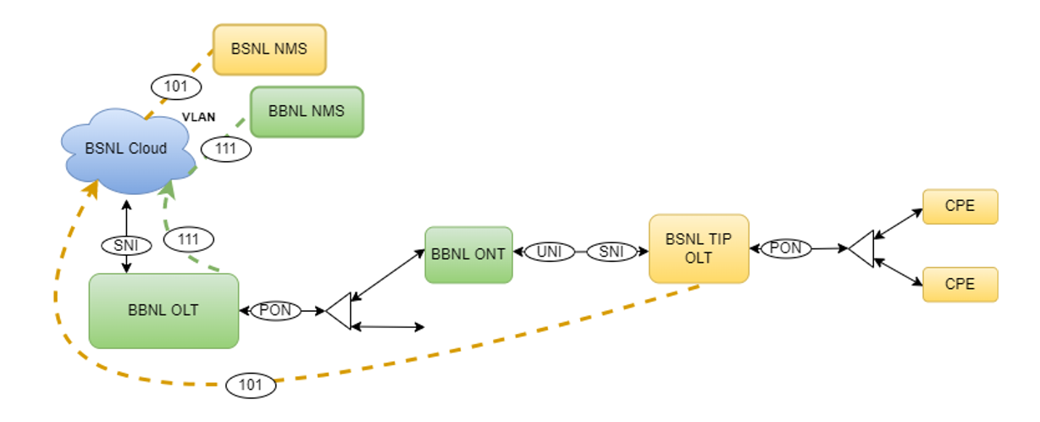
Possibility 3 : GP Level connections through BharatNet ONTs
(Model 4-2)
In this scenario, BBNL OLT & BBNL ONT will be used.
BBNL OLT & ONT will pass the VLANs (Service & Management traffic) transparently from BSNL backhaul to the BSNL TIP OLT.
Configurations required at BBNL OLT & BBNL ONT will be done from BBNL NMS by the BBNL NOC team.
Configurations at BSNL BNG & TIP OLT will be done by BSNL team
Different technologies require different types of configurations. Number of VLANs that can be passed are also different.
BBNL & BSNL OLTs will be managed/monitored by their respective NMSs.

Slide 7
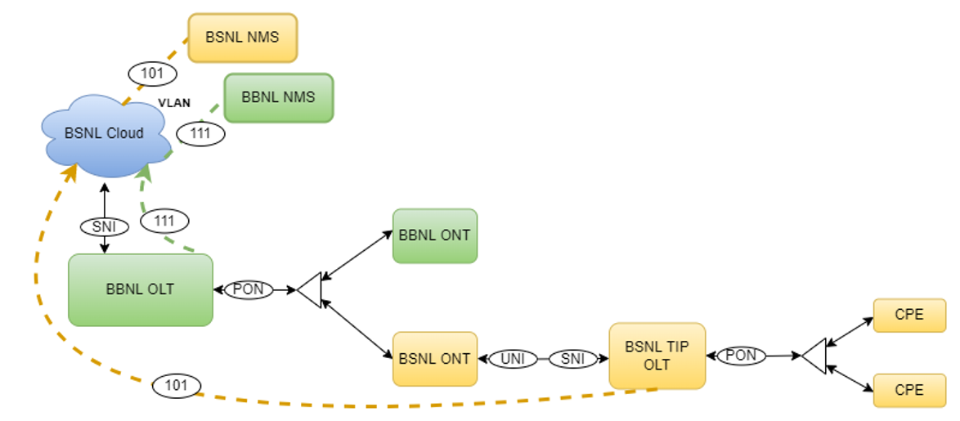
Possibility 4: Block/GP Level connections through BSNL ONTs Model 4-3
This is same as Possibility 3 except for that in stead of BBNL ONT, a BSNL ONT is used directly at the PON level or through splitter before the GP ONT.
In this scenario, only BBNL OLT will be used.
BSNL ONT should be compatible with the BBNL OLT

Slide 8
Possibility 5 : Block/GP level connections through partner OLT utilizing BBNL Dark Fiber
(Model 4-4)
TIP OLT backhaul can be extended from BBNL OLT location using spare fibre available between BBNL OLT location and TIP OLT location
This will be totally independent of BharatNet electronics. The OLT & ONT will be directly controlled by BSNL

Slide 9
Thank You!

